Slide 1
Introduction to Intelligent Systems
Refresher Module

Slide 2

Google Colaboratory
Colaboratory, or “Colab” for short, is a product from Google Research. Colab allows anybody to write and execute arbitrary python code through the browser, and is especially well suited to machine learning, data analysis and education. More technically, Colab is a hosted Jupyter notebook service that requires no setup to use, while providing access free of charge to computing resources including GPUs.
Reference: https://research.google.com/colaboratory/faq.html

Slide 3
Pytorch
PyTorch is a Python-based scientific computing package serving two broad purposes:
A replacement for NumPy to use the power of GPUs and other accelerators.
An automatic differentiation library that is useful to implement neural networks.
Reference: https://pytorch.org/tutorials/beginner/blitz/tensor_tutorial.html

Slide 4
AutoGrad
torch.autograd is PyTorch’s automatic differentiation engine that powers neural network training.
Training of Neural networks happens in two steps:
Forward Propagation
Backward Propagation
Reference: https://pytorch.org/tutorials/beginner/blitz/autograd_tutorial.html#sphx-glr-beginner-blitz-autograd-tutorial-py

Slide 5
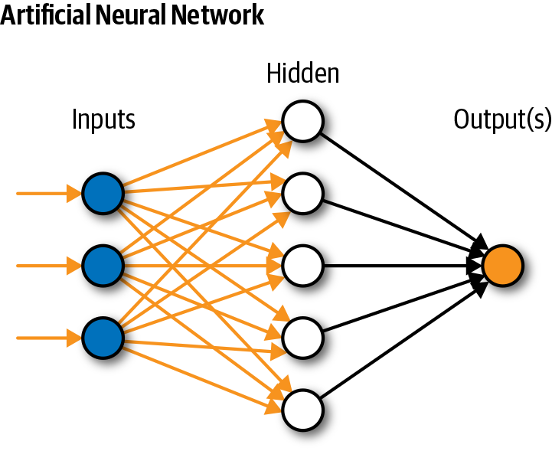
Neural Networks
Neural networks reflect the behavior of the human brain, allowing computer programs to recognize patterns and solve common problems in the fields of AI, machine learning, and deep learning.
Reference: https://www.ibm.com/in-en/topics/neural-networks

Slide 6
Neural Networks
Neural networks can be constructed using the torch.nn package.
Reference: https://pytorch.org/tutorials/beginner/blitz/neural_networks_tutorial.html#sphx-glr-beginner-blitz-neural-networks-tutorial-py

Slide 7
Training a classifier
Reference : https://pytorch.org/tutorials/beginner/blitz/cifar10_tutorial.html#sphx-glr-beginner-blitz-cifar10-tutorial-py

Slide 8
Some more references
Deep Learning Playlists:
https://youtube.com/playlist?list=PLeo1K3hjS3uu7CxAacxVndI4bE_o3BDtO
https://youtube.com/playlist?list=PLZoTAELRMXVPGU70ZGsckrMdr0FteeRUi
Machine Learning Playlists:
https://youtube.com/playlist?list=PLZoTAELRMXVPBTrWtJkn3wWQxZkmTXGwe
https://youtube.com/playlist?list=PLeo1K3hjS3uvCeTYTeyfe0-rN5r8zn9rw

